Slide 1
CS174A Lecture 14

Slide 2
Announcements & Reminders
3/06/24: A4 due; will be discussed during this week’s TA session
3/07/23: Prof Demetri’s presentation (Zoom, no recording)
Team Project Timelines: see project info document on Canvas
Team project grade increased from 150 to 175 (download latest team project info)
3/19/24: Final exam, 6:30-8:15 PM, in person, location TBD
Final exam grade reduced from 150 to 125 (download latest syllabus)
Study guide and book exercises posted
3/18 & 3/19: Office hours, Noon-1PM

Slide 3
TA Session This Friday
Team project midway demos

Slide 4
Last Lecture Recap
Non-Photorealistic Rendering
Global Illumination: Radiosity
Mappings: Texture, Bump, Displacement, Environment
Shadows
Shadow volumes
2-pass z-buffer algorithm

Slide 5
Next Up
Hidden Surface Removal
Ray casting
Ray Tracing

Slide 6
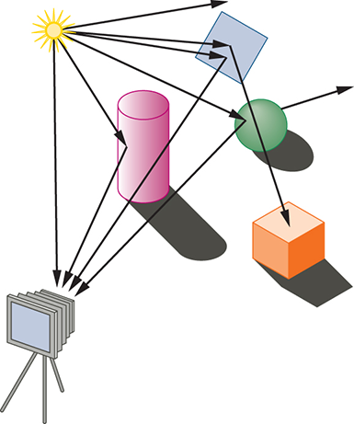
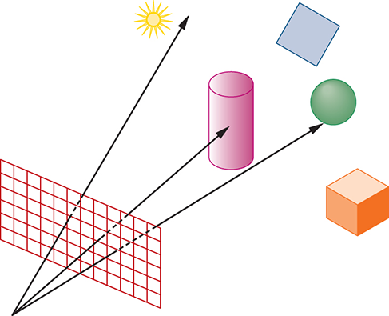
HSR: Ray Casting Algorithm
Forward vs. backward ray casting

Slide 7
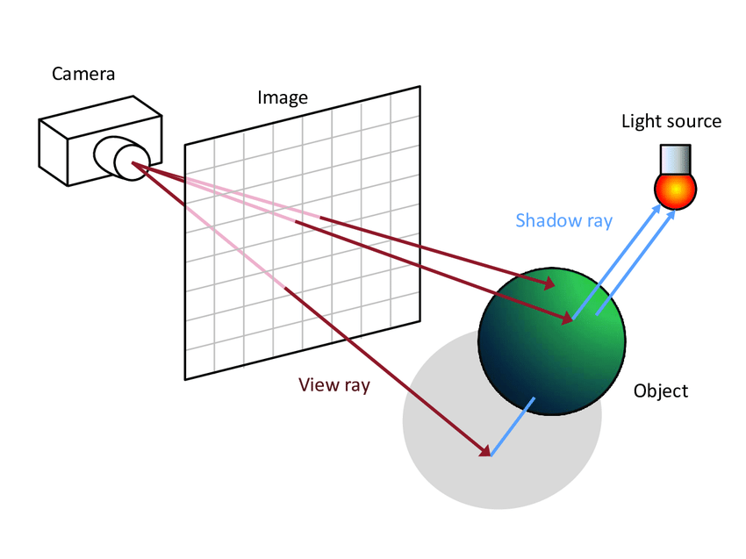
HSR: Ray Casting Algorithm
Ray Casting is a WS or ES visible surface algorithm
Window is divided into a rectangular array of pixels
Algorithm
For each pixel in viewport
Generate ray emanating from Eye (O) through pixel
Find intersection between ray and objects
Pick intersection point closest to Eye (O)
Illuminate the closest intersection point
Plot pixel with illuminated color of closest object

Slide 8
Ray Casting Pipeline
MODEL
SPACE
Transformation
Matrix (4x4 TM)
WORLD
SPACE
Eye
Matrix (4x4 EM)
EYE
SPACE
Translation, Scaling, Rotation, Shear
Eye, COI, Top/Tilt
X
Window-To-Viewport Mapping (4x4 WTV)
Projection
Matrix (4x4 PM)
SCREEN
SPACE
(VIEWPORT)
PROJECTION
SPACE
NORMALIZED PROJECTION
SPACE
(WINDOW)
X
X
Viewport: lower-left, upper-right
Pers Divide
Aspect Ratio, Half Angle of View, Hither, Yon

Slide 9
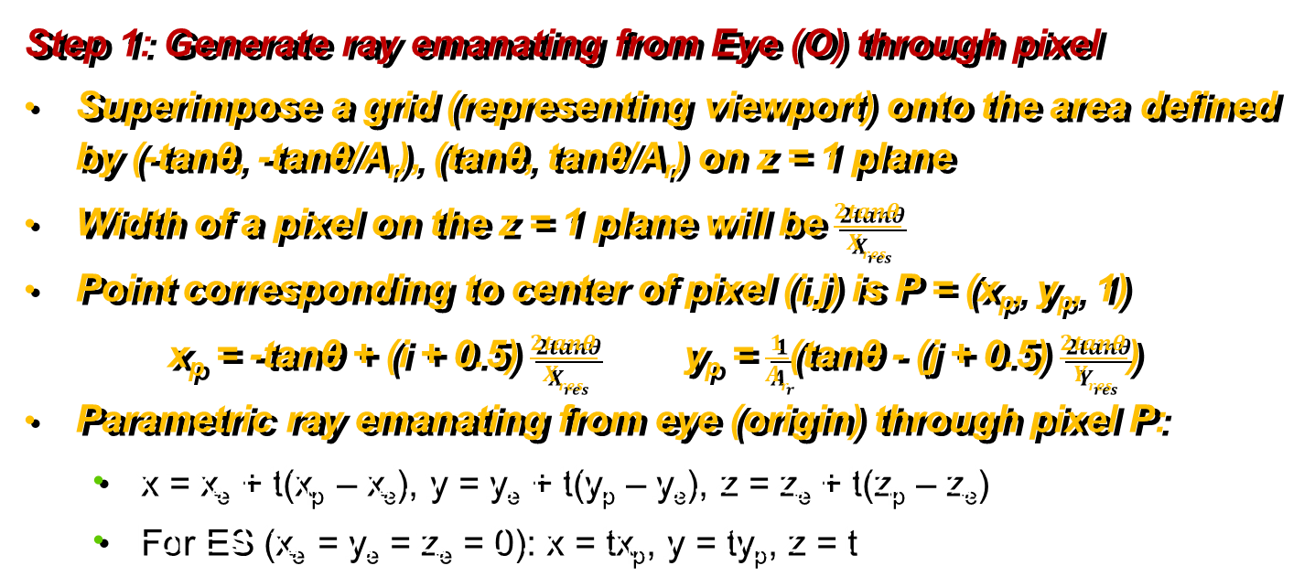
Ray Casting Algorithm
Step 1: Generate ray emanating from Eye (O) through pixel
Superimpose a grid (representing viewport) onto the area defined by (-tanθ, -tanθ/A_{r}), (tanθ, tanθ/A_{r}) on z = 1 plane
Width of a pixel on the z = 1 plane will be $\frac{2tanθ}{Xres}$
Point corresponding to center of pixel (i,j) is P = (x_{p}, y_{p}, 1)
x_{p} = -tanθ + (i + 0.5) $\frac{2tanθ}{Xres}$ y_{p} = $\frac{1}{Ar}$(tanθ - (j + 0.5) $\frac{2tanθ}{Yres}$)
Parametric ray emanating from eye (origin) through pixel P:
x = x_{e} + t(x_{p} – x_{e}), y = y_{e} + t(y_{p} – y_{e}), z = z_{e} + t(z_{p} – z_{e})
For ES (x_{e} = y_{e} = z_{e} = 0): x = tx_{p}, y = ty_{p}, z = t

Slide 10
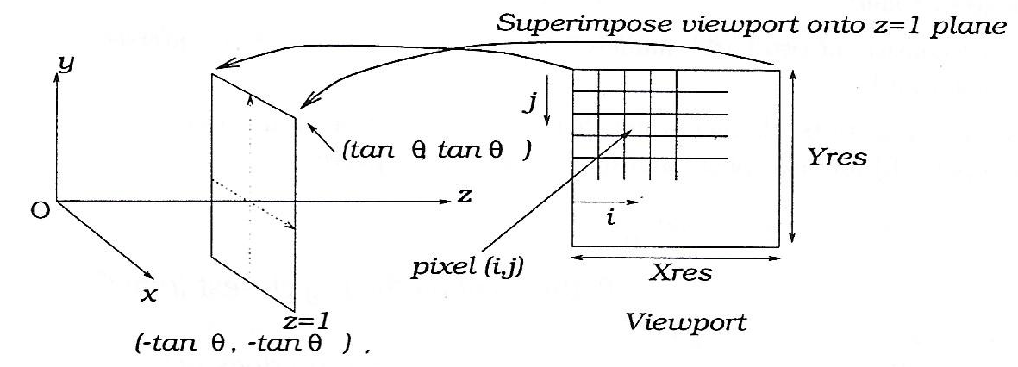
Ray Casting Algorithm
Step 1: Generate ray emanating from Eye (O) through pixel

Slide 11
Ray Casting Algorithm
Step 2: Find intersection between ray and objects
Intersection test: if no intersection, skip part b
Intersection calculation: for spheres and for polygons

Slide 12
Ray Casting Spheres
For spheres
Transform center of sphere to ES (radius remains same)
Equation of sphere: (x – x_{c})² + (y – y_{c})² + (z – z_{c})² – R² = 0
Parametric equation of ray (ES): x = tx_{p}, y = ty_{p}, z = t
Find intersection of ray with sphere: plug in eqn of ray in eqn of sphere At² + Bt + C = 0
No real solution ⇒ ray does not intersect sphere
1 real solution ⇒ ray grazes sphere
2 real solutions ⇒ entering & exiting points, pick lower +ve t, and calculate P
Find normal at intersection point P: N = P – P_{c}
Illuminate using P, N, E of closest +ve t

Slide 13
Ray Casting Polygons
For polygons
Transform poly to ES
Equation of the plane containing poly: Ax + By + Cz + D = 0
Parametric equation of ray (ES): x = tx_{p}, y = ty_{p}, z = t
Find intersection of ray with plane: plug in eqn of ray in eqn of plane
If denom = 0, ray is parallel to plane ⇒ no intersection
Check if intersection point P is contained inside the poly
Project poly and point onto one of the primary planes (use max of N components)
Use one of the “point inside poly” tests
Find normal N at intersection point using bilinear interpolation
Illuminate using P, N, E of closest +ve t

Slide 14
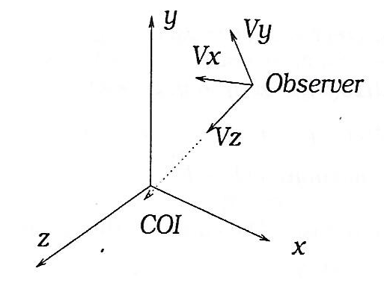
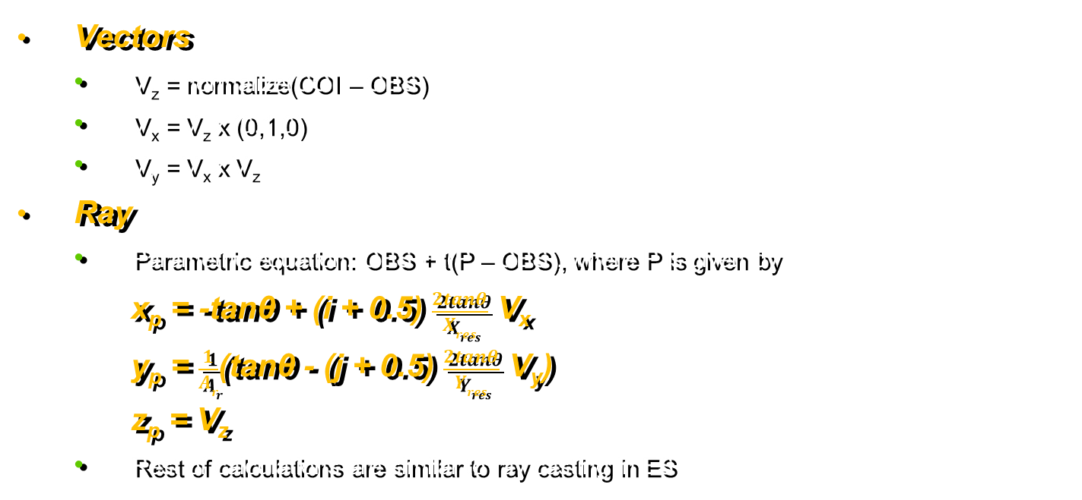
Ray Casting in World Space
Vectors
V_{z} = normalize(COI – OBS)
V_{x} = V_{z} x (0,1,0)
V_{y} = V_{x} x V_{z}
Ray
Parametric equation: OBS + t(P – OBS), where P is given by
x_{p} = -tanθ + (i + 0.5) $\frac{2tanθ}{Xres}$ V_{x}
y_{p} = $\frac{1}{Ar}$(tanθ - (j + 0.5) $\frac{2tanθ}{Yres}$ V_{y})
z_{p} = V_{z}
Rest of calculations are similar to ray casting in ES

Slide 15
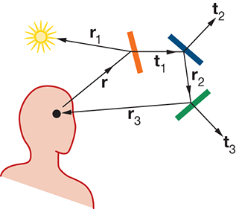
Ray Tracing
Also referred to as Recursive Ray Tracing
Handles reflections, refractions, shadows
Primary ray: ray from eye into the world
Secondary rays: reflected, refracted, shadow
Illumination for ray tree: I = ambient + diffuse + specular + k_{r}I_{r} + k_{t}I_{t} k_{r}: coefficient of reflection [0..1] k_{t}: coefficient of transmission [0..1]
Attenuate I_{r} and I_{t} by distance the ray travels

Slide 16
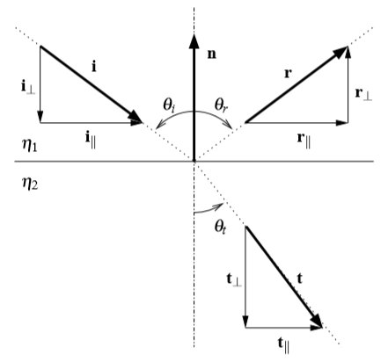

Ray Tracing
Reflected Ray Direction
r = i – 2(i·n)n
Refracted Ray Direction
Snell’s Law: η₁sinθ_{i} = η₂sinθ_{t}
t = $\frac{η1}{η2}$i + ($\frac{η1}{η2}$cosθ_{i} - $\sqrt{1 −sin2θt}$)n
sin²θ_{t} = ($\frac{η1}{η2}$)²sin²θ_{i} = ($\frac{η1}{η2}$)²(1 - cos²θ_{i})

Slide 17
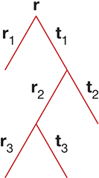
Ray Tracing: Illumination
Ray Tree
Formed of primary, secondary, shadow rays
Evaluated bottom up

Slide 18
Ray Tracing: Rendering Time
Max # rays & intersection calculations
m = # light sources; d = depth of ray-tree, N = # polys in scene
# of primary+reflection+transmission rays = 2^{d} – 1
# of shadow rays = m(2^{d} – 1)
# rays per pixel = (m + 1)(2^{d} – 1)
# rays for entire screen = X_{res}*Y_{res}*(m + 1)(2^{d} – 1)
# intersection calcs = N* X_{res}*Y_{res}*(m + 1)(2^{d} – 1)
Back faces cannot be culled
Clipping cannot be done for view volume or behind eye
75%-95% of time is spent in intersection calculations

Slide 19
Ray Tracing: Acceleration Techniques
Reduce number of rays: Early Tree Termination
No intersection for a ray
Tree depth has reached a specified level
Intensity of I_{r} or I_{t} becomes very low
Secondary ray has traveled a max distance
Reduce number of intersection calcs
Bounding boxes or bounding spheres
Hierarchical bounding boxes
Spatial subdivision: quadtree, octree

